Slide 1
Submission and defence of the bachelor thesis
Curriculum Design and Testing Committee
Faculty of Computer Science and Information Technology (FCSIT)
Riga Technical University
Approved by the Council of FCSIT at its meeting on 9 January 2023 (Minutes No: 12000-1.1/1)

Slide 2
Submission of the bachelor thesis

Slide 3
Electronic form
Printed form
This path is recommended but it requires an e-signature
The student uploads the electronic copy of the thesis in PDF format (signed by a secure electronic signature) to the register of graduate papers on the RTU ORTUS portal
The student confirms that the thesis has been developed independently and has not been plagiarized
The supervisor approves the submission of the thesis
The student uploads the electronic copy of the thesis in PDF format to the register of graduate papers on the RTU ORTUS portal
The student obtains a declaration that the thesis has been developed independently and has not been plagiarized, and that the electronic copy of the thesis is identical to its printed copy
The student prints out the declaration, signs it manually and attaches it to the printed copy of the thesis
The student signs the printed copy of the thesis and submits it to the person responsible for thesis collection
The supervisor approves the submission of the thesis
Submission of the bachelor thesis

Slide 4
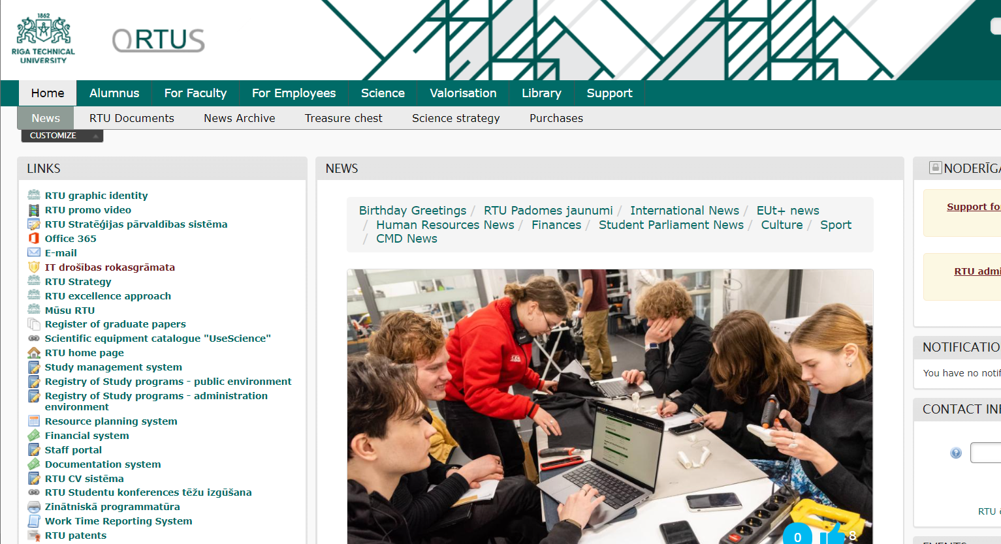
Access to the register of graduate papers
The link to the register of graduate papers

Slide 5
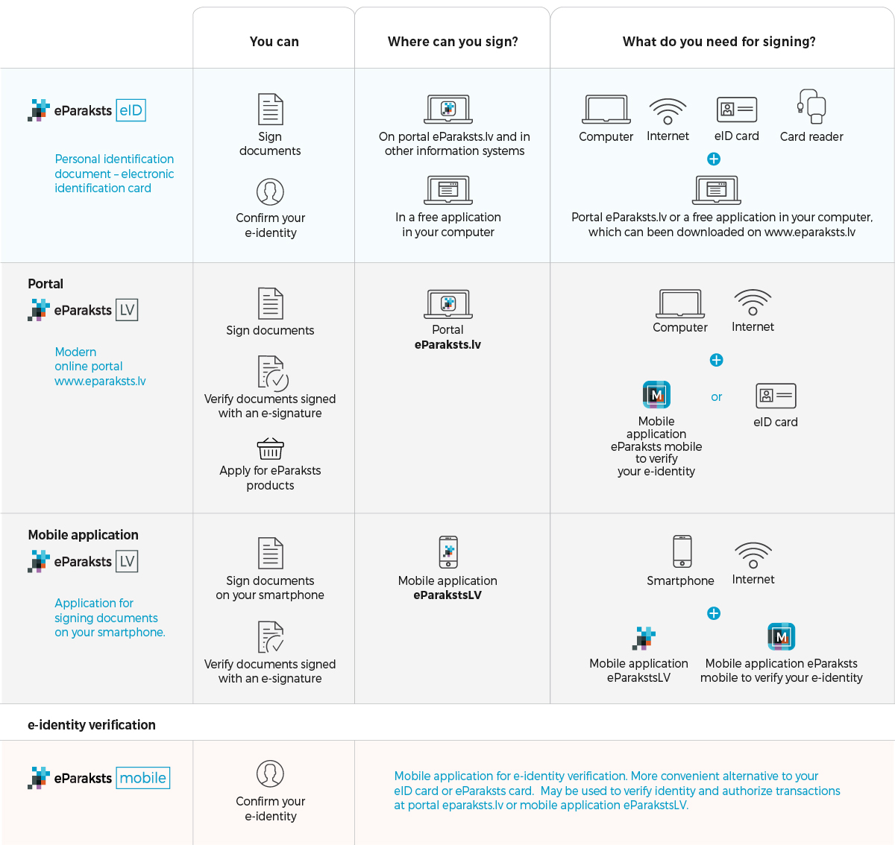
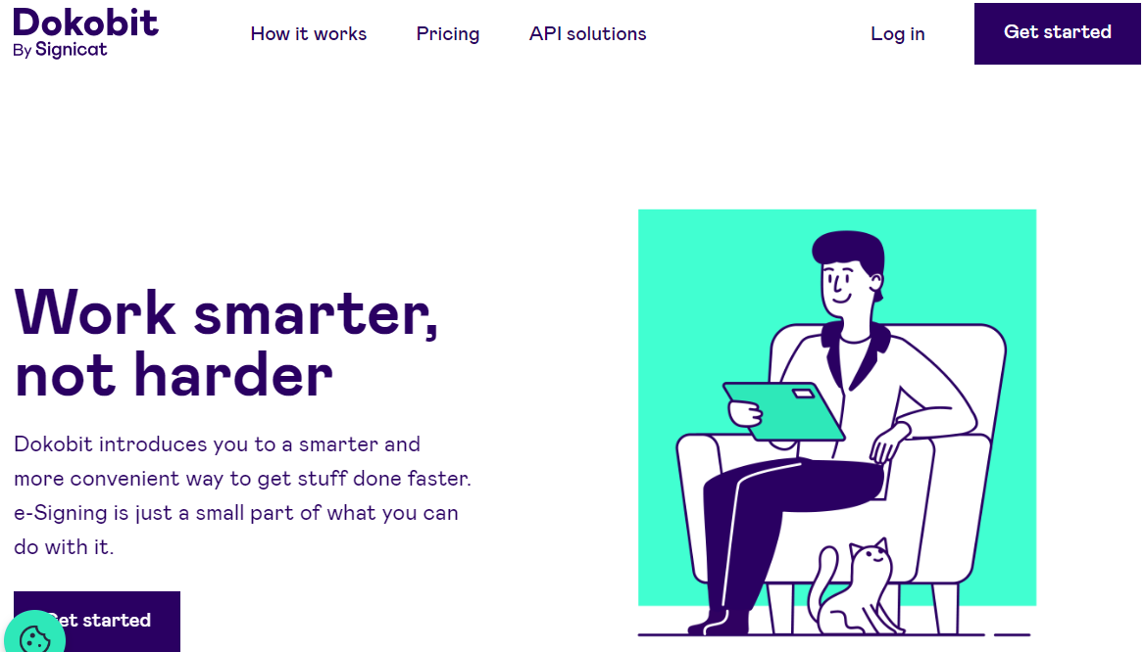
Obtaining an e-signature
https://www.eparaksts.lv/lv/
Must apply a few days in advance
Free of charge
https://dokobit.com/lv/
Registration with Smart-id
5 free signatures per month
https://www.edoks.lv
Registration with Smart-id
10 free signatures

Slide 6
Defence of the bachelor thesis

Slide 7
Defence
The defence is public
It takes place in front of the Final Examination Committee, which consists of:
the chair of the committee: the head of the study program or a professor or associate professor appointed thereby
at least two members of the committee: specialists in the respective field of science holding a doctoral or master degree
The defence consists of a presentation of the thesis and a speech prepared by the student

Slide 8
Defence: process
Student's presentation and speech – 10 min
The student may disagree with the opinions of the reviewer and/or the supervisor but then he/she must prove his/her opinion with thesis-based arguments
Answers to questions of the committee and others
Reading the reviewer's review
Reading the supervisor’s reference
The student's answers or comments regarding the information provided in the review and supervisor’s reference

Slide 9
Defence: outcomes
A passing grade has been received in the defence
A failing grade has been received in the defence
The bachelor thesis has not been submitted for the defence within the term set by the faculty
The bachelor thesis has been developed and submitted within the term set by the faculty, the supervisor’s approval with regard to the readiness of the thesis has been received and the thesis has been submitted for review, but the student has not participated in the defence
The student is exmatriculated for academic failure or the head of the study program may decide that a new bachelor thesis should be developed or the student may continue working on the selected topic
If a new bachelor thesis is developed, the student must pay a fee set by the RTU Senate for the re-development of the bachelor thesis
If the work on the existing topic is continued, the student must pay a fee set by the RTU Senate for completing the bachelor thesis
The student may be granted an academic leave until the next committee meeting
The student must pay a fee set by the RTU Senate for the untimely of repeated taking of the final exam within the study program
The student is exmatriculated due to the completion of studies
During graduation, the student receives a diploma

Slide 10
Defence: answers to questions
Listen very carefully
Ask to repeat a question if necessary
Answer concisely and clearly
Remember that it is better to openly say that you do not know the answer than to “compose" an answer

Slide 11
Defence: behaviour
Dress code:
 | Business style of dress should be observed
Behavoiur:
 | Behavior must follow the rules of business etiquette If violations of the norms of behavior are committed, the chair of the committee has the right to stop the defence and postpone it to another time
 | Look at the audience and talk to them
 | Do not read text from a piece of paper or slide
 | Do not stand in front of the presentation on the screen

Slide 12
The student reads from a piece of paper or slides rather than speaks
The student skips slides, saying almost nothing about them
Presentation slides are cluttered with text that cannot be read
Main mistakes made at the defence
The student speaks too fast and "runs" through slides
The student uses visual content (tables, pictures, diagrams, etc.) that cannot be seen
The presentation contains only text with no visual content

Slide 13
Defence: submitting an appeal
The student is eligible to submit an appeal regarding the conduct of the defence
The student submits an appeal to the dean of the faculty
The appeal must be submitted not later than by the end of the next business day after the defence
The dean shall establish a committee to consider the appeal, excluding the members of the final examination committee whose activity is appealed
The Appeals Committee makes a decision and communicates it to the student in writing
The committee's decision must be made not later than in 5 business days after receiving the appeal

Slide 14
Evaluation of the bachelor thesis

Slide 15
The bachelor thesis is evaluated by
Supervisor
Reviewer
Committee
With yes/no/partly:
whether the planned tasks have been completed
whether the content of the thesis is relevant to the topic
whether the thesis is a completed research work
whether the technical quality of the thesis meets the requirements of the field
whether the formatting of the thesis complies with the faculty’s guidelines
In a more details:
evaluation of the systematic development of the bachelor thesis and cooperation with the supervisor
the student's ability to use the results of current research and to do research independently
theoretical and practical significance of the bachelor thesis
With yes/no/partly:
whether the content of the thesis corresponds to the thesis title
whether the volume of the thesis in pages meets the requirements of the bachelor thesis
whether the topicality of the thesis is justified
whether the goal and tasks of the thesis are defined
whether the goal of the thesis has been achieved and the tasks have been completed
whether the thesis structure corresponds to the tasks
whether the conclusions of the thesis are drawn from the work completed
how many terminology, grammatical and stylistic mistakes there are
whether information sources included in the list of references are referenced in the thesis
whether the number of information sources is adequate for the content of the thesis, and their quality is satisfactory
whether the results achieved by the student can be identified in the thesis
The committee takes into account:
reviewer’s evaluation
reference of the supervisor
the quality of the student’s presentation and speech
the quality of the answers to the questions related both to the developed bachelor thesis and to the most important fundamental theoretical and special science study courses of the field
the overall quality of the bachelor thesis in terms of content, presentation, used sources of information and language of description

Slide 16
Content and quality of the presentation
Content of the student's speech
When evaluating the quality of student’s presentation and speech, the following is taken into account:
Clear evidence that the tasks defined in the thesis have been completed and the set goal has been achieved
Clearly presented results obtained by the student
Compliance with the defence time limit

Slide 17
The structure of the bachelor thesis presentation

Slide 18
Activity
Contents of Presentation
Introduce yourself, the title of the bachelor thesis and the supervisor to the committee and others
Title slide: 1 slide, mandatory
Inform about the content of the presentation
Contents slide: 1 slide, preferable
Emphasize what has been done in the analytical and solution parts of the thesis, and demonstrate the results of the solution verification
Emphasize the topicality of the bachelor thesis and the essence of the researched problem
Topicality slide: 1-2 slides, mandatory
Define the goal and tasks of the bachelor thesis
Slide of the goal and tasks: 1-2 slides, mandatory
Speak about the work done and the results achieved
The number and titles of the slides depend on the content of the thesis
Outline the conclusions
Conclusions slide: 1-2 slides, mandatory
Indicate possible directions for the continuation of the thesis
Future work slide: 1 slide, preferable
Thank the committee and listeners for their attention and invite questions
Final slide: 1 slaids, mandatory

Slide 19
Title slide and contents slide
The title slide must include:
 | The title of the bachelor thesis
 | First and last name of the student
 | First and last name of the supervisor (preferably also position and scientific degree)
 | First and last name of the consultant if there has been one (preferably also position and scientific degree)
In addition, the title slide may, but is not mandatory, include:
 | The department in which the thesis is defended
 | Date of the defence
Contents slide:
 | It lists the main sections of the presentation

Slide 20
Slides of thesis topicality, goal and tasks
The aim of thesis topicality slide is:
✓ | To draw attention to the thesis by emphasizing why its topic or research problem is important
The goal and tasks slide:
✓ | Remember that the thesis goal must be specific and measurable (measurable that it has been achieved)
✓ | Tasks must be derived from the goal and enable it to be achieved
✓ | When presenting the thesis, it is necessary to prove that all the tasks have been completed and the goal has been achieved

Slide 21
Slides of work done and results
Content of the work done and results slides:
✓ | These slides are directly related to information presented in the main chapters of the bachelor thesis
✓ | There is no need to present the theory, but the greatest emphasis should be placed directly on: the result of the analytical part of the the thesis and the identified problems the developed practical solution and its verification
✓ | Regarding the theory covered in the thesis, the presentation should provide an explanation of key terms and/or ideas
✓ | Key terms and ideas are those that allow the audience to better understand your work and especially your contribution to solving the research problem

Slide 22
Conclusions slide
Content of the conclusions slide:
✓ | It is not simply a summary
✓ | It should reflect the findings that the listeners should remember
✓ | It should reflect what you have concluded after the analysis performed in the thesis, the development and verification of your practical solution

Slide 23
Future work and final slides
Future work slide:
✓ | Add this slide only if you really see opportunities for you or other researchers to continue your research in future
✓ | Show that you can analyze and see perspective
Content of the final slide:
✓ | At the end of the presentation: Thank listeners for attention Invite the audience to ask questions
✓ | In addition, you can put your contact information on this slide

Slide 24
Tips for preparing the presentation

Slide 25
Access to the graphic identity of the faculty
A link to faculty logos and MS Power Point presentation templates

Slide 26
Presentation and speech preparation
Prepare an initial version of the presentation
Show the presentation to the supervisor to get feedback
Improve the presentation according to the supervisor's comments
Write speech
Practice presenting in front of a mirror or an audience, taking your time
Arrange with the supervisor to rehearse the speech and presentation a few days before the defence

Slide 27
Slide content:
 | Reflect the main points, not the entire text you will be narrating
 | Emphasize the essentials, not the details feature of long-term memory: the audience will remember only one or two things from the presentation
 | Information on the slides should be structured
Slide numbering:
 | Do not forget to number the slides so that the committee can refer to them when asking questions, and you can refer to them when answering the questions
Style:
 | Choose and stick to a consistent style throughout your presentation, i.e. fonts, colors, etc.
 | Use the default font and color schemes
 | Don't use too many different styles as they are distracting
 | Avoid using a dark background

Slide 28
Amount of text per slide:
 | Do not put a lot of text on one slide, but stick to the principle of one idea per slide
 | If you put too much text in a small font, your audience won't read it: Too much text make a slide cluttered and difficult to read Why should the audience waste their energy reading the text if you're going to tell it? People's reading speed does not match their listening speed; instead of aiding understanding, the text can create confusion
Font size:
 | The size of characters used in the title must not be less than 28
 | The size of text characters should not be less than 18
 | Do not write text only in capital letters it makes the text hard to read it obscures acronyms it negates their usefulness for emphasizing an aspect

Slide 29
Fonts:
 | Choose a font that is clearly readable Arial is good and clear Roman style typefaces are easier to read than Script or Old English
 | Use no more than two font types
 | To make word to stand out, change its font or background
Italics:
 | Use it for 'quoted' text
 | Use it to highlight/emphasise a thought or idea
 | Use it for titles of books, magazines or journals
 | Use it for terms in the original language
Bold:
 | Don't write all the text with it
 | Use it to highlight/emphasise a thought or idea

Slide 30
Use of bullet points:
 | Bullet points serve as reminders
 | They help to "prepare" the audience for what you will tell
 | They can help to remember what you said
Size of bullet points:
 | The size of text should not be larger than 22
Number of bullet points:
 | The text of each bullet should be laid out in no more than 1-2 lines
 | The maximum number of bullet points per slide is 5-7

Slide 31
Figures and tables:
 | If possible, show the results of the thesis in tables, figures and charts
 | One picture is worth a thousand words
 | Use images as visual metaphors
Animation:
 | Don't get carried away with animation and visual effects, use them only to draw attention to important aspects of the presentation
 | Your task is to get the audience to focus on "what" you're saying, not "how" you're saying it, that is, focus on "content" rather than "form"

Slide 32
Tips for preparing the defence speech

Slide 33
Prepare your narrative well:
 | To make your speech fluent and clear
 | To make sure that the presentation would not be a surprise to you
 | To fit into the defence time limit
Requirements for speech content:
 | The speech should emphasize essential aspects, not details
 | The speech should provide more information than is covered on a slide
 | Feel free to use new words and specific terms BUT only if you know what they mean and how to pronounce them

Slide 34
Requirements for speaking style:
 | Speak in a clear voice and so audience can hear you
 | Speak in complete sentences
 | Do not read long monotonous text passages from a piece of paper or slides
Keep time:
 | The time for each slide is approximately 1-2 minutes (so the total number of slides for a 10-minute presentation is 8-12 slides)

Slide 35
Have a successful defence of your bachelor thesis!
Curriculum Design and Testing Committee
Faculty of Computer Science and Information Technology
Riga Technical University

