Slide 1
Bachelor thesis development in the 6th semester: general aspects
Curriculum Design and Testing Committee
Faculty of Computer Science and Information Technology (FCSIT)
Riga Technical University
Approved by the Council of FCSIT at its meeting on 9 January 2023 (Minutes No: 12000-1.1/1)

Slide 2
Volume of the bachelor thesis and development activities

Slide 3
Volume of the bachelor thesis in the 6th semester
Study program: Computer Systems
Credit points | Working day equivalent | Final evaluation
8 KP | 30 full working days | Final grade in the public defence

Slide 4
Bachelor thesis development activities in the 6th semester
Activity | Deadline
A seminar about general aspects of the bachelor thesis development | Week #2
Progress report | Week #9
Bachelor thesis pre-defence | Week #12
A seminar about bachelor thesis submission and defence | Week #13
Submission of the bachelor thesis | Week #17 Tuesday
Defence of the bachelor thesis | Week #19
*precise deadlines are available in the user-created e-study course “Computer System Thesis”

Slide 5
Progress report
It is designed to follow the regularity and progress of the development of the bachelor thesis, aiming towards the desired result and the level of quality
Students report the course of development of the bachelor thesis and the obtained intermediate results
It is mandatory
The results of the progress control affect the evaluation given by the supervisor and are a decisive criterion for admission to the defence of the bachelor thesis
The student must submit a written report
The detailed information is given in the user-created e-study course “Computer Systems Thesis"

Slide 6
To evaluate the progress of the development of the bachelor thesis
To decide on admitting the student to the final defence
To provide recommendations for the improvement of the bachelor thesis
To provide the student with the experience of defending the thesis
The goals of the pre-defence
To direct the student to further thesis development activities

Slide 7
Pre-defence: the essence
In the pre-defence, students present to the commission what has been done in the bachelor thesis and what is still missing
The pre-defence is similar to the procedure for defending the bachelor thesis
Student participation is mandatory, if students plan to defend their bachelor thesis at the end of the 6th semester
The most detailed information is given in the user-created e-study course “Computer Systems Thesis"

Slide 8
Pre-defence: results
The pre-defence is successful
The pre-defence is unsuccessful
The student doesn’t attend the pre-defence for an objective reason
The student doesn’t attend the pre-defence for a non-objective reason
The student is admitted to the defence in the 6th semester
The student is not allowed to defend this semester
Another time for the pre-defence is offered to the student
The student is not allowed to defend this semester

Slide 9
Pre-defence: process
The student submits the thesis at its current state of readiness to the user-created e-study course “Computer Systems Thesis”
A week before the pre-defence
The student presents the thesis at its current state of readiness (up to 10 min)
The student answers questions form the commission
Within two days after the pre-defence
Results published in the user-created e-study course “Computer Systems Thesis”

Slide 10
Pre-defence: Student’s presentation
Topicality of the bachelor thesis and/or research motivation
The goal of the bachelor thesis and the tasks set for achieving it
Content of the thesis: what content will be included in the thesis, and why this content is relevant to the thesis
Significant findings from the analysis of information sources and a list of the most relevant information sources
Work done on the thesis: what tasks have already been completed, what results have already been obtained, what insights have already been gained, etc.
Planned work: what tasks need to be completed and/or what results still need to be obtained before the submission of the bachelor thesis
Conclusions and obstacles in the process of developing the bachelor thesis
A template is available at:
https://www.rtu.lv/lv/ditf/studijas-ditf/noderigi-dokumenti-un-saites

Slide 11
Pre-defence: tips and rules
The focus should be on what has been done and what remains to be done
Be able to convince the commission that the student is deep into the topic and will be able to complete their research in the remaining time
A business style of dress must be observed
Behaviour in the presentation must conform to the norms of business etiquette
Make an effort to look at the audience and talk to them
Do not stand in front of the presentation on the screen
Do not read from a piece of paper or slide
Don't be afraid to draw attention to the presentation with gestures
Use a pointer or pen to show something in the presentation

Slide 12
Amount of work done (at least 75% of the total amount of work)
A clear and actionable plan to get the rest done
Evaluation criteria in the pre-defence
Understanding of the topic when the student answers questions from the commission

Slide 13
Pre-defence: Preparation
Prepare a presentation
Show the presentation to the supervisor to receive feedback
Improve the presentation according to the supervisor's comments
Write a speech
Practice presenting in front of a mirror or an audience, taking your time

Slide 14
Specific aspects of bachelor thesis development

Slide 15
Cooperation scenario in the 6th semester
To monitor the regularity of the development of the bachelor thesis and compliance with its development schedule
To consult with the supervisor on issues related to the development of the bachelor thesis
To consult on the selection of relevant information sources and research methods
To continue developing the analytical part of the bachelor thesis, searching, analyzing and collecting information sources
To provide comments on the intermediate results of the bachelor thesis development
To develop a bachelor thesis solution and verify it
To provide recommendations for presentation and speech preparation for the pre-defence and defence
To present the results of the bachelor thesis in the pre-defence
Supervisor
Student
To emphasize meeting the requirements regarding the content, structure, formatting, language and style of the thesis
To prepare and submit the final version of the bachelor thesis
To prepare a reference of the bachelor thesis
To present the final version of the bachelor thesis in the defence

Slide 16
Recommendations for cooperation with the supervisor
Feedback from the supervisor must be used effectively:
All comments made by the supervisor must be carefully considered
According to the comments, corrections should be made in the entire text of the bachelor thesis
Do not repeat the mistakes that were pointed out earlier
The student must systematically work on the bachelor thesis, regularly demonstrating the intermediate results of the work to the supervisor
The supervisor should be informed in a timely manner about difficulties and problems related to the development of the bachelor thesis

Slide 17
Research logics
Problem
An unknown to be discovered or a contradiction to be resolved
The goal of the thesis
The goal to solve the problem
Tasks
Tasks to achieve the goal
One aspect derives from the other and matches with the others
Research
Research that addresses the problem
The problem can be solved in different ways:
initially studying it analytically and then moving on to developing a solution
starting the development of a solution and then justifying it analytically
simultaneously studying it analytically and developing a solution
Analytical part
Solution and its verification part
Analytical part
Solution and its verification part
Analytical part
Solution and its verification part
Conclusions
Conclusions obtained during the research

Slide 18
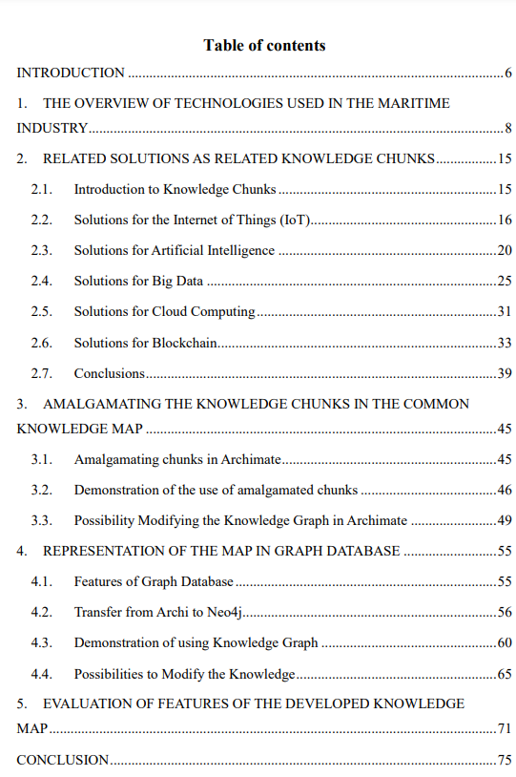
From results to thesis structure
Results of the analytical part
Results of the solution and its verification part
Analytical part
One or more chapters of the bachelor thesis
One or more chapters of the bachelor thesis
Solution and its verification part
Bachelor thesis

Slide 19
Goal and tasks - 1
The goal clearly defines the expected result, the student's contribution or the problem to be solved
Tasks describe actions that must be performed to achieve the defined goal
Completing each task brings the student closer to achieving the goal
The bachelor thesis has one goal and several tasks are defined to achieve it

Slide 20
Goal and tasks - 2
The goal must be evaluable or measurable (after conducting the research, it can be determined that the goal has/has not been achieved)
Tasks must be specific to the bachelor thesis, not general (for example, “collect information sources”, “define basic concepts” are general tasks applicable to every research)
Tasks should reflect activities specific to the student’s research:
“to get to know", “to look", “to create an idea" are not research activities
“to analyze", “to compare", “to define regularities", “to develop", “to design", etc. are research activities

Slide 21
Solution part
If a piece of software is developed, then usually its concept is described, the main functional and non-functional requirements are defined, the system’s architecture and the technologies to be used are specified, the user’s manual is included, and the results of the software performance test are added
If a new/modified algorithm is developed, it is described, and its performance and comparison results with existing similar algorithms are included
Guidelines and recommendations must result from a very detailed analytical overview or experiments or be based on expert opinion (for example, by conducting an expert survey)
If a comparison of algorithms/methodologies/frameworks etc. is made in the solution part, then the bachelor thesis must define and justify the comparison methodology, and the comparison must be based on the student's experimental measurements. Criteria values cannot be just borrowed from literature or subjectively evaluated

Slide 22
Solution part
In the case of comparison, both the selection of criteria and their values must be justified
How will it be proven that these criteria make it possible to choose the best/most effective, etc. product/method?
The student's self-defined values mean nothing because another person can choose them differently. Therefore, they are also subjective and not allowed!
Criterion | Product/method #1 | Product/method #2 | Product/method #3
Ease of use | 5 | 1 | 3
Number of supported file types | 2 | 4 | 2
Attractiveness of the interface | 3 | 5 | 4
“Number of supported file types" is the only objectively measurable criterion, the value of which can be obtained from the product/method documentation
"Ease of use" and "attractiveness of the interface" are subjective criteria: it may be easy/attractive for one and not for another. Such criteria are not allowed!

Slide 23
Scientific language
The bachelor thesis must be written using scientific language
Scientific language style means writing clearly, logically and laconically, not dryly and complicated
Analytical part
Solution and its verification part
The text is structured by organizing it into chapters and sections
The text has a logical connection
Chapter 1
Chapter 2
…
Paragraph 1
Praragraph 2
…
Each chapter/
paragraph/
sentence
should be derived from the previous text
Sentence 1
Sentence 2
…

Slide 24
Scientific language
Redundancy is not allowed (laconic, but not lack of explanation)
Emotionally neutral expression and neutral vocabulary are used, expressing text precisely, clearly, logically, sequentially and in a structured manner
Sentences are connected by conjunctions and other linking words (but, so that, although, because, moreover, thus, etc.)
Field-accepted terminology is used
Explanations of newly introduced terms are given
Consistency in the use of terms is observed

Slide 25
Scientific language
The past participle of the verb is used, for example, not – “I did the research”, but – “the research was done”
The text is supplemented with visual information: formulas, tables, figures, diagrams, etc.
References to the works of other authors are used
The norms of language and writing, especially orthography and punctuation, are strictly observed

Slide 26
Scientific language
Scientific language also requires that the student clearly separates his/her contribution from other authors’ results
This can be achieved by using the following phrases:
“The analysis of information sources shows...”
“As a result of the analysis of information sources/In the bachelor thesis, it has been identified/clarified/developed/offered...”
“The author of the bachelor thesis has developed/identified/found/proposed/concluded...”
“Taking together the above information, it is concluded...”

Slide 27
Useful tools
Terminology and translation
termini.gov.lv – Latvia's National Terminology Portal, where industry terminology approved in Latvia is available
https://www.zinatnesvaloda.lv/frazes - Phrases used in scientific Latvian language
https://www.phrasebank.manchester.ac.uk/ - Phrases used in scientific English language
https://www.letonika.lv/groups/default.aspx?g=2 – Dictionaries of terms
https://www.eurotermbank.com/ - Terminology Bank of European Union
https://hugo.lv/lv - State administration language tools

Slide 28
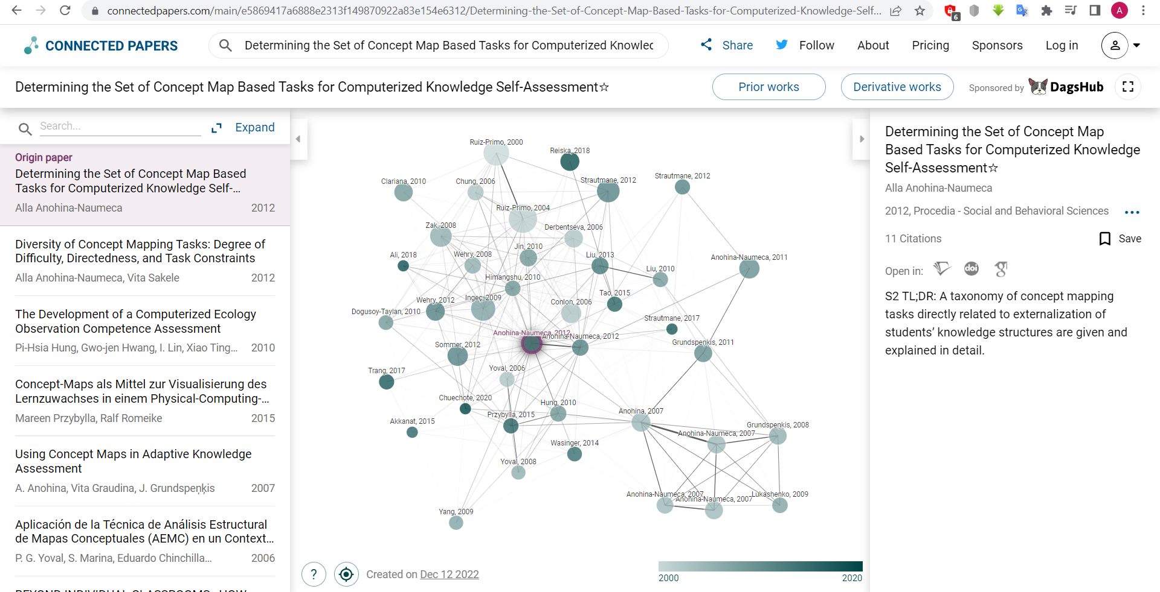
Useful tools
https://www.connectedpapers.com/ - Searching for related publications and studies

Slide 29
Useful tools
Reference management tools
https://www.zotero.org - A free tool that allows collecting, organizing and referencing various types of information resources
https://www.mendeley.com/ - A free tool that allows organizing a list of information sources, connecting with other researchers, searching for articles, and more
https://www.citavi.com/en - A tool (free trial is available) that allows collecting and organizing information resources, searching databases, downloading *.pdf articles, annotating the articles and inserting references
https://endnote.com/ - A paid tool that allows searching bibliographic databases, organizing a list of references and information sources, etc.

Slide 30
Thoughtful, well-structured and logical content
Scientific language and few grammar/syntax mistakes
Good bachelor thesis
A precisely formulated goal and tasks to be completed to achieve it
Formatting according to requirements
Content-rich analytical part
Clearly presented student’s contribution
Significant solution and its verification part

Slide 31
Have a successful bachelor thesis development process!
Curriculum Design and Testing Committee
Faculty of Computer Science and Information Technology
Riga Technical University

