Slide 1
Starting the bachelor thesis development
Curriculum Design and Testing Committee
Faculty of Computer Science and Information Technology (FCSIT)
Riga Technical University
Approved by the Council of FCSIT at its meeting on 12 September 2022 (Minutes No: 12000-1.1/13)

Slide 2
Volume and structure of the bachelor thesis

Slide 3
Volume of the bachelor thesis
The minimal volume of the bachelor thesis is 50 pages
It is recommended not to exceed 80 pages
All pages are counted, starting from the title page and excluding the list of references and appendixes to the bachelor thesis
Page number on the title page is not written

Slide 4
Sections of the bachelor thesis
Section | Comments
Title page | Basic information about the bachelor thesis; a template is available
Work Performance and Assessment Sheet | Approvement of the bachelor thesis development; a template is available
Abstract | 3–5 key words describing the field of research A brief description of the content of the bachelor thesis Information on the volume of the bachelor thesis (number of pages, figures, tables, appendixes and sources of reference)
Anotācija | The translation of the abstract into Latvian
Table of Contents | The structure of the bachelor thesis, comprising headings of all three levels and respective page numbers
Introduction | Substantiation of the topicality of the theme and/or rationale for research The goal of the bachelor thesis and the tasks set to complete the goal A brief description of the content of the sections and appendixes of the bachelor thesis
Sections of the body of the thesis | Description of the conducted research
Results and Conclusions | Summary of the research conducted and results obtained Author’s personal conclusions and lessons learned Areas for further research Author's achievements related to the thesis (publications, presentations at the conferences, participation in the research projects)
List of References | The list of information sources referred to in the body of the bachelor thesis
Appendix(es) | Explanatory information not included in the body of the bachelor thesis
https://www.rtu.lv/lv/ditf/studijas-ditf/noderigi-dokumenti-un-saites:
FCSIT Formatting and Style Guidelines for Graduation Thesis
FCSIT final thesis template

Slide 5
Parties involved in the development of the bachelor thesis and cooperation with the supervisor

Slide 6
The bachelor thesis is developed under the supervision of a bachelor thesis supervisor
An expert in scientific research
An expert in a particular scientific subfield
An expert in the bachelor thesis development process and requirements
Student
Supervisor/scientific adviser
(mandatory)
Consultant
(optional)
A member of academic personnel of RTU or an employee of another organisation holding a doctoral or master degree in the respective industry or an employee with the highest professional qualification (level 5)

Slide 7
Student's responsibilities
The student must remember that the bachelor thesis is a student’s original work
The thesis supervisor and/or consultant provide basic recommendations and advice and guide the development of the thesis
Thus, the student is fully responsible for the development of the bachelor thesis:
the decisions taken,
the correctness and reliability of the facts presented, the data obtained, and the calculations made,
the quality of the formatting of the bachelor thesis, and
compliance with the deadlines set for the bachelor thesis development

Slide 8
Supervisor’s duties
To consult the identification of the research direction and the choice of the topic
To consult the formulation of the goal and tasks of the thesis, the schedule for the thesis development, and the structure of the thesis
To examine the bachelor thesis submitted for the defence and to prepare a written reference of the student's bachelor thesis
To consult the selection of information sources relevant to the bachelor thesis
To provide guidance and assistance to the student in preparation for the progress control and the defence of the bachelor thesis
To consult the selection of research methods relevant to the bachelor thesis
Supervisor
To follow the development of the bachelor thesis, providing feedback on necessary changes and improvements

Slide 9
A contributor to research
An information source finder
A grammar teacher
A translator of the abstract into Latvian
The supervisor IS NOT
A technical editor of the bachelor thesis

Slide 10
Student’s duties
To work systematically and regularly on the bachelor thesis, presenting progress to the supervisor
To adhere to the deadlines defined for the development of the bachelor thesis
To develop an original work, avoiding breaches of academic integrity (plagiarism, falsification of data, etc.)
To participate in consultations with the supervisor at the agreed time (preferable)
To follow the guidelines for the graduation thesis formatting defined by the faculty
As far as possible to take into account feedback provided by the supervisor
Student
To defend the bachelor thesis
To participate in progress control events

Slide 11
Student
Supervisor
If the student is not satisfied with the cooperation with the supervisor, he/she has the right to:
Change a supervisor
Find a consultant
If the supervisor is not satisfied with the cooperation with the student, he/she has the right to:
Not to accept the bachelor thesis for the defence and refuse to give a supervisor’s reference

Slide 12
Cooperation scenario in the 5th semester
The goal, tasks and schedule of the bachelor thesis are described in the thesis topic selection application
To recommend initial information sources
To study the recommended information sources
To advise on the selection of relevant information sources for the bachelor thesis
To search for additional information sources
Supervisor
To consult regarding the development of the bachelor thesis
To define questions related to the development of the bachelor thesis
Student
To check compliance with the requirements concerning reporting in the 5th semester
Report for the work done in the 5th semester

Slide 13
Search and analysis of information sources

Slide 14
BACHELOR THESIS
Analytical part
A structured summary of information sources
Practical solution part
A solution developed independently by the student
VERIFICATION OF THE SOLUTION PART
Verification results of the solution developed by the student
Search and analysis of information sources

Slide 15
The aim of the analysis of information sources:
to find out what is already known
to get evidence of it
What and how have other researchers studied similar issues?
What essential conclusions have they made?
What still needs to be resolved?
How to justify the topicality of the bachelor thesis research?

Slide 16
The content of the analytical part of the bachelor thesis depends on the topic of the thesis and the expected solution within it
Analysis of theories relevant to the topic
Summary and analysis of results obtained by other authors
Definitions of concepts relevant to the topic
Analytical part of the bachelor thesis
Current state in the field and development trends
From multiple different information sources to a single research

Slide 17
Development of the analytical part
Collecting information sources
Reading and analysing the information sources
Summarising the facts revealed
Representing a summary in the thesis

Slide 18
The more sources of information collected, the better
What the student reads, summarizes and analyzes will determine the quality of the thesis
Collecting information sources
Sources of information must be:
scientific (they cannot be popular scientific or pseudo-scientific; see next slide)
up-to-date
obtained from recognized sources
When collecting and reading information sources, it is recommended to make a list of sources immediately, keeping bibliographic information
Automated tools such as Mendeley can be used to store bibliographic information

Slide 19
Collecting information sources
Books and monographs relevant to the topic
Peer-reviewed articles in proceedings
Articles in scientific journals
Information sources to be used
It is essential that the author and the year of publication are clearly identifiable
Developer documentation
Doctoral dissertations
Project reports
Recognized standards and patents

Slide 20
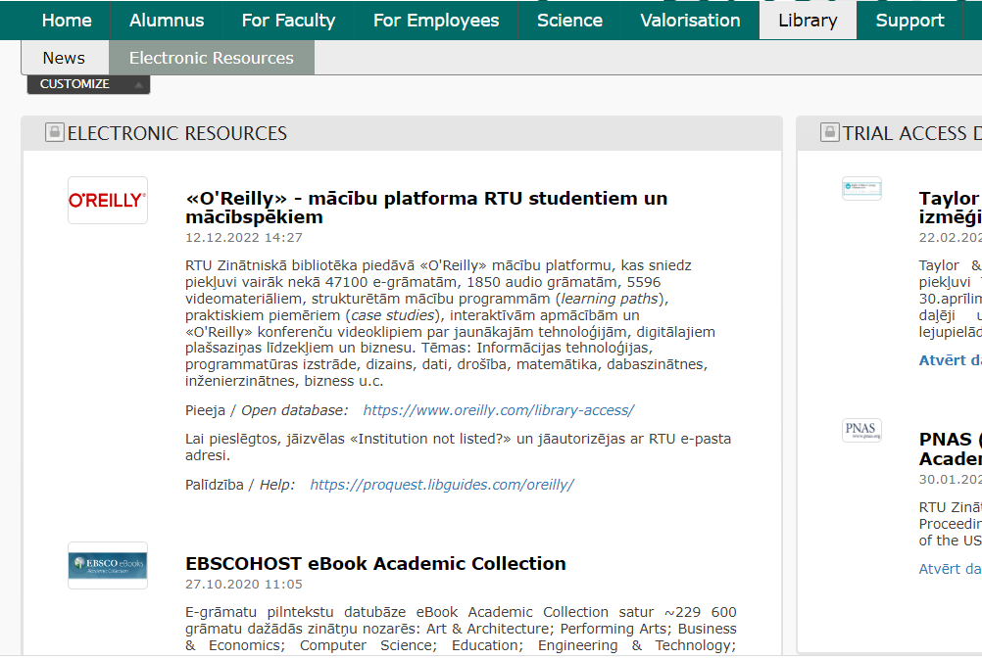
Collecting information sources
In a browser, use the search function with keywords relevant to the thesis topic
Places to search for information sources
Digital libraries accessible from RTU Library (IEEE Xplore Digital Library, ACM Digital Library and others)

Slide 21
Collecting information sources
Wikipedia
Personal and organisational blogs
Any articles and websites without the author's name and year of publication
Avoid using the following information sources
Student papers and coursework

Slide 22
To have something to write about in the bachelor thesis, the student needs to read and read
During reading, the student should capture aspects that are relevant to the topic of the bachelor thesis
Reading and analysing the information sources
Take notes, don’t create an essay
The extracted content should be kept together with a reference to the source of information to avoid plagiarism during the writing of the final version of the bachelor thesis

Slide 23
Summarising the facts revealed
For each of the aspects identified before, it is necessary to determine:
similarities
differences
special cases
Use references to keep information about information sources

Slide 24
Representing a summary in the thesis
Collecting information sources
i₁
i₂
i₃
i_{x}
The more sources the student finds, the better
Reading and analysing the information sources, identifying those aspects that are relevant to the topic
Tasks solved
History
Advantages
Drawbacks
Aspects are specific to each topic and only a few examples are given here
Characteristics
Methods used
Application areas
Developing a summary together with references to information sources
Text-based facts and conclusions
Lists, classifications, categorizations
Tables
Diagrams, charts, pictures
Examples created by the student
Structured description
All this is a student’s contribution to the analytical part of the bachelor thesis!

Slide 25
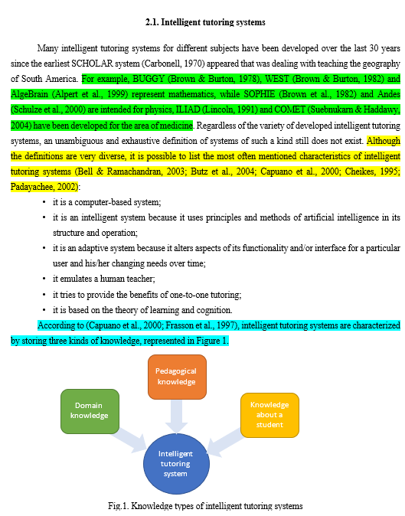
Representing a summary in the thesis
An example of a summary, where:
The green text highlights a list
The yellow text indicates the characteristics extracted from several information sources by the author of the bachelor thesis
The light-blue text explains the picture that the author of the bachelor thesis has developed about knowledge types based on information from two sources

Slide 26
Academic integrity

Slide 27
A bachelor thesis must not include statements without evidence
Statements and evidence:
They may be derived from research works of other authors and included into the bachelor thesis in the form of quotations and paraphrases and are marked in the bachelor thesis by references to specific information sources
They may be student's conclusions from the text previously included in the bachelor thesis with references to information sources (a summary of what has been described above)
They may be derived from student's contributions and work done (the solution developed and the results of its verification)

Slide 28
Statements in the analytical part
Allowed
Forbidden
Quotations
Plagiarism
with references and “”
BACHELOR THESIS
Paraphrases
with references
A thesis consisting only of quotations and paraphrases has little value and is considered “patchwork” plagiarism
Student’s contribution
clearly identifiable

Slide 29
Only a few (the most important) are allowed in the bachelor thesis
Quotation marks are mandatory
Quotations
A direct copy of a passage of text
Reference to the information source is mandatory
EXAMPLE:
“Machine learning typically involves adaptive mechanisms that allow computers to learn from experience, learn by example, and learn by analogy” (Negnevitsky, 2011)

Slide 30
Paraphrase
Retelling ideas/information represented in an information source in student’s words
Reference to the information source is mandatory
EXAMPLE:
The field of machine learning is associated with adaptive mechanisms that enable computers to use different types of learning: learning from experience, learning by example and learning by analogy (Negnevitsky, 2011)

Slide 31
Conclusions drawn from the previously written text that has references to information sources
Clearly separated from the rest of the text using the introductory words "The author of the bachelor thesis concludes/has claimed/ developed/defined/proved..."
A solution developed by the student
Student’s contribution
Without references to information sources
Student’s conclusions based on results of verification of the solution

Slide 32
Plagiarism
Plagiarism corresponds to the situation when, in the bachelor thesis, the student 1) uses words, ideas or work results 2) developed by another person or found in some information source 3) without reference to that person or work
Plagiarism most often arises if information sources are not recorded during the development of the bachelor thesis, and the analysis and summarisation of information sources is basically not carried out
Plagiarism can have different manifestations:
the borrowed text is directly copied,
the borrowed text is paraphrased,
the borrowed text is a combination of sentences from different sources,
and other (check the RTU document “Breach of Academic Integrity and Breach Consideration Procedures” for more types of plagiarism)

Slide 33
Plagiarism
Plagiarism control of the bachelor thesis is mandatory at RTU
It is done using two systems:
International system Turnitin
The system developed at the faculty
A commission established by the faculty examines each identified case of plagiarism
If the commission decides that there is plagiarism in the bachelor thesis, the student is not admitted to the defence of the thesis and is unable to finish his/her studies

Slide 34
Most common mistakes
Mistakes that may be considered a breach of academic integrity:
The thesis contains copies of large passages of text from one or a few information sources, without referring to the sources (lack of summarization)
References are mainly given at the end of a paragraph or several paragraphs (lack of summarization)
The thesis contains a direct copy of the text from an information source together with the references used in that source
The thesis contains false references to information sources from which the text was not taken
The thesis contains text taken from an information source that has been processed using automated paraphrasing tools
The student submits a solution created by another author as his own
The student falsifies or fabricates research results or data
and other

Slide 35
Research methods

Slide 36
Any research is carried out based on a research methodology
The research methodology defines precisely how the research will be conducted to achieve the defined research goal, complete the research tasks and produce reliable results
Thus, the research methodology determines the timing and sequence of the work to be carried out, the methods for acquiring and processing data and other aspects of the research
The research methodology is based on the use of research methods
A research method is a technique for obtaining evidence and data that allow discovering the nature of the object of research and thus achieving the goal of the research

Slide 37
Quantitative methods
Qualitative methods
Research methods
Look for answers to the questions "Why...?" and “How…?"
Help to understand the research object from a particular perspective or point of view
Usually collect data in the form of words or graphic objects through observation and recording of opinions
Collect subjective data (opinions, assumptions, goals, insights, values, and motives)
Look for answers to the questions "How much...?" and "How often...?"
Help to discover the facts about the research object and explain regularities between them
Typically collect numerical data
Collect objective data by making measurements

Slide 38
Quantitative methods
Qualitative methods
Research methods
Direct observations
Focus groups
Surveys
Unstructured interviews
Unstructured surveys
Document analysis
Case study
Field studies
Structured interviews
Structured surveys
Experiments
Correlation studies

Slide 39
There are many research methods
Typically, any research uses several methods simultaneously
Below are just a few examples of the most common methods used in computer science
However, it should be noted that these are not all possible methods
To understand what methods are relevant for the bachelor thesis, the student is advised to:
consult with the supervisor of the bachelor thesis
get in-depth information by studying literature on research methods

Slide 40
Common research methods in computer science
Survey:
The survey is usually conducted using a questionnaire or interview developed by the student
When conducting a survey, it is essential to determine how many and what respondents are needed (sample size and elements) to obtain reliable results
Example: A survey about the use of programming languages in Latvian companies
Case study:
The situational analysis allows an in-depth study of one specific situation/event/use case/phenomenon
Typically, a large amount of descriptive data about a situation are collected and processed
Example: Development and application of a new document migration software in a given company

Slide 41
Common research methods in computer science
Experiment:
It allows the investigation of causal relationships based on the conditions defined by the researcher and/or the environment created
It is typically used to determine and/or test parameters (e.g. performance) of a developed solution and/or compare a solution with similar solutions
An experiment can be: a) an experiment with a real object, b) an experiment with a model of the object (imitation models, etc.), and c) the result of mathematical calculations/derivations
Example: Performance testing of a new machine learning algorithm
Modelling:
It involves creating and testing a simplified physical, conceptual, or computerized representation of a real-world object or environment
Example: development of enterprise business process models

Slide 42
Common research methods in computer science
Simulation:
It allows investigating in detail characteristics of the developed solution and making a prediction about what can happen to it under certain conditions
Simulation typically uses specialized software because it is expensive or impossible to test the solution in the real world
Example: traffic regulation in different ways at the crossroads of Slokas and Kalnciema streets

Slide 43
Books available at RTU Central Library
Trochim W.M., Donnelly J.P., Arora K. (2016). Research methods: the essential knowledge base. Boston, MA : Cengage Learning
Mārtinsone K., Pipere A., Kamerāde D. (2016). Pētniecība: teorija un prakse. Rīga: RaKa
Thiel D.V. (2014). Research methods for engineers. Cambridge: Cambridge University Press
Wieringa R.J. (2014). Design Science Methodology for Information Systems and Software Engineering. Heidelberg: Springer
Jackson S.L. (2012). Research methods and statistics: a critical thinking approach. Wadsworth Cengage Learning

Slide 44
Have a successful bachelor thesis development process!
Curriculum Design and Testing Committee
Faculty of Computer Science and Information Technology
Riga Technical University

