Slide 1
Get recruited
Step by step
guidance
RTU Student Service
1

Slide 2
Before you start your career journey – please, check for official formalities
https://www.liaa.gov.lv/en

Slide 3
Steps we advise to concider
1. Consider your goals first. What do you want to find?
2. Analyze your previous experience
3. Do field research. Select vacancies or companies
Prepare or adapt your CV and cover letter
Send an application
Have a successful interview

Slide 4
Consider your goals
What is my goal?
CV for job or internship may differ. CV for Latvian or International market
may differ also.
What position I am aiming at?
Intern or professional? Junior or expert? Local business or International company? State or private company?
What kind of impression you would like to make?

Slide 5
Selecting vacancies
In selection process you can focus in two directions:
Work tasks and content
Companies or brands
Chances will increase, if you:
Visit Open Days and other events organized by companies,
Register your CV on vacancy websites and LinkedIn,
Ask around you friends,
Pay attention to information boards in University.

Slide 6
Vacancies that suits me
Ads at Portals, agencies, RTU related portals, boards etc.
Companies websites, career fairs, Open days etc.
6

Slide 7
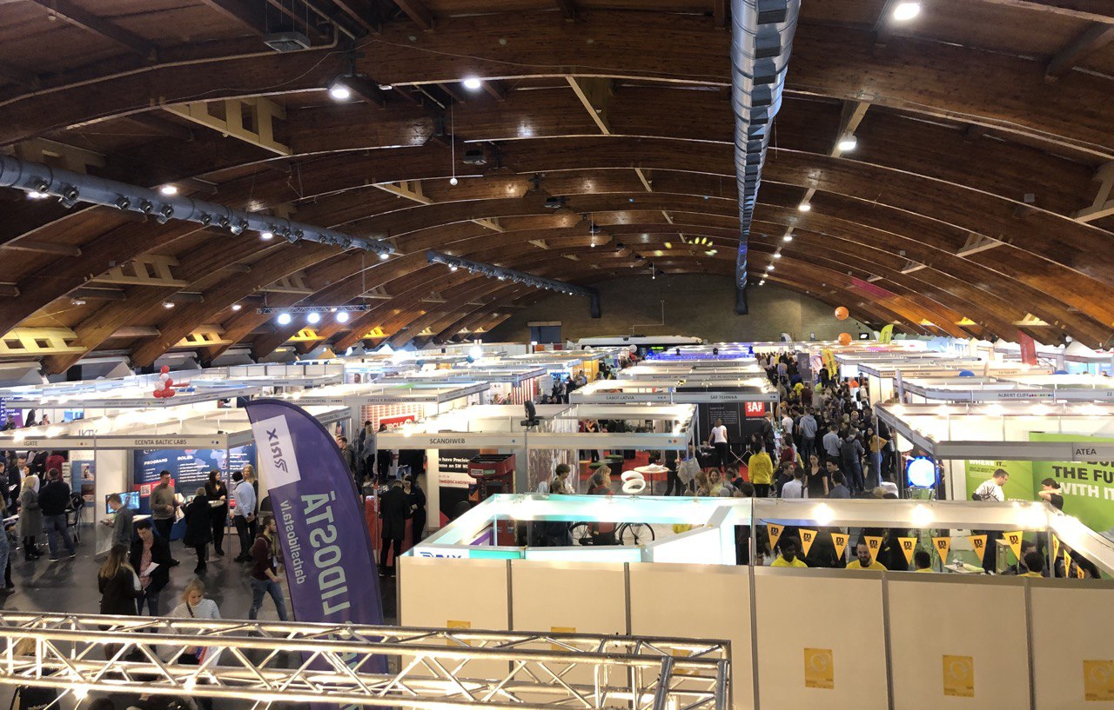
RTU Career day
Event takes place each year in spring. Career day brings together companies and job seekers from RTU and other institutions. More information about event and it’s history HERE

Slide 8
Application documents: CV
CV is the first impression about you.
It is important not only WHAT you are sending, but also HOW you do it.
Before you make your CV, ask yourself:
What kind of impression you would like to make?
Which CV form is the best for this purpose?

Slide 9
CV forms

Slide 16
If you have a struggle, what format to choose...
...any CV format is good, if it is:
consistent with job position,
clear written,
well structured,
contains all needed information.

Slide 17
Photo: it is not obligatory, but if you choose to use photo, take a professional one.
Personal data: name, surname, e-mail, telephone, address (factual).
Profile: short description, professional aims,
limitations (if you have some).
Education: start with current.
Experience: work experience.
Additional experience: you can add info about projects, volonteering, exchange.
Languages
Skills: technical, soft skills.
CV
structure and content
Optional: references, hobbies.
18

Slide 18
Questions to concider:
Cover letter
What kind of impression I want to make?
What I know about position and company?
How will I explain my value for company?
How my skills and experience meet company requirements?

Slide 19
Cover letter:
Creating more personal picture of you.
Providing your motivation.
Explaining what allows you to be succesfull in current position.
https://europa.eu/europass/en

Slide 21
Check before sending
Good grammar, clear structure.
One font type and size.
Text is adapted for vacancy.
Same language as the job ad.
Correct contact information of yours.
Correct name of CV and cover letter (e.g., name_surname_CV).
CV and Cover letter saved in PDF
CV is not longer that 2 pages, Cover letter – 1 page.
Give someone to read before sending

Slide 22
Depending on the company, there are various ways of holding a job interview:
Job interview
a conversation held by one or two people;
a test or task;
group interview;
phone or video call interview.

Slide 23
Pay attention to first contact and first impression you make: e-mail, phone conversation, social media.
Before an interview
Prepare 2-4 sentences story that describes you.
Use some relaxation, breathing or warming up practice , if it is needed.

Slide 24
Most frequent asked quesions:
Prepare a short story;
Think before; Do a research about company, salaries.
Tell about yourself? What do you know about company?
Why did you apply?
Your biggest acievements? When you can start?
What salary do you expect?

Slide 25
RTU Student service
Web page: rtu.lv/en/studentservice
Facebook: RTU Studentu serviss Instagram: rtu_studentu_serviss
Adress: Āzenes street 6, 1st floor
Email: ssc@rtu.lv or karjera@rtu.lv
More tips and information at RTU Career center

